Slide 1
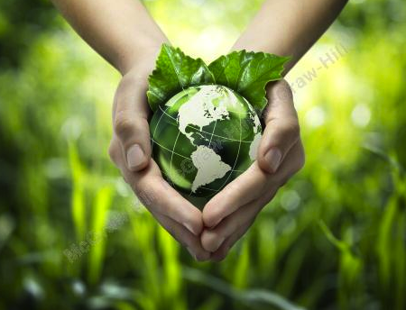
Sustainable Development and Global Business
Chapter 9
©2020 McGraw-Hill Education. All rights reserved. Authorized only for instructor use in the classroom. No reproduction or further distribution permitted without the prior written consent of McGraw-Hill Education.

Slide 2
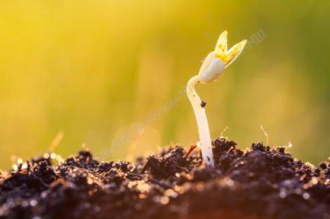


Business and Society in the Natural Environment
Business and society operate within constraints of the planet and its resources.
Notes:
Natural Capital: World’s stocks of natural assets, including its geology, soil, air, water and all living things.
For human society to survive over time it must operate sustainably, so that natural resources are preserved for future generations.
Preserving our common ecosystem is an urgent imperative for governments, business, and society.

Slide 3
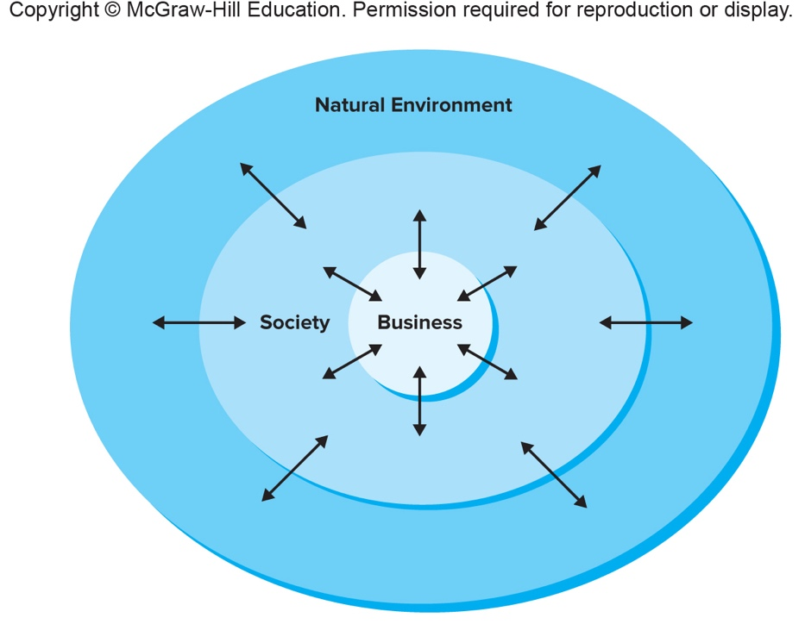
Business, Society and the Natural Environment: An Interactive System
Figure 9.1
Copyright © McGraw-Hill Education. Permission required for reproduction or display.
Access the text alternative for these images.

Slide 4

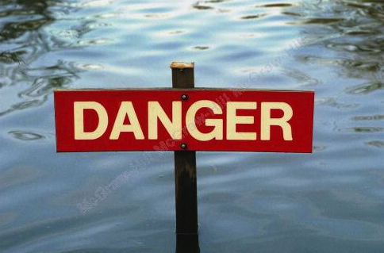
Considerations you will face
Sustainable Development
Threats to the Earth’s Ecosystem
Notes:
Sustainable Development
Development that “meets the needs of the present without compromising the ability of future generations to meet their own needs.”
Sustainable development requires that human society use natural resources at a rate that can be continued over an indefinite period.
Sustainable development is about fairness. The benefits and burdens of the use of natural resources must be distributed equitably:
Between developed and developing countries.
Between present and future generations.
Threats to the Earth’s Ecosystem
Humanity has entered a new era, called the Anthropocene, in which human activity has become the dominant influence on climate and the environment.
Businesses now face:
Limited supplies of critical resources.
Unpredictable weather changes.
Increased political risk.
But business also have great opportunities:
Established firms and innovative entrepreneurs who can figure out how to address environmental challenges can both help society and enjoy great commercial success.

Slide 5
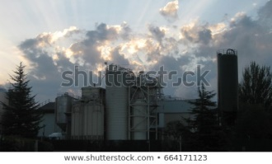
Forces of Change Accelerating Ecological Crisis
Two critical factors have combined to accelerate the ecological crisis facing the world community and to make sustainable development more difficult:
  The population explosion.
  Economic development.
Notes:
Population Explosion
A major driver of environmental degradation is the exponential growth of the world’s population.
Many more people would be added during the second 50 years than during the first, even though the rate of growth would stay the same.
Economic Development
Another source of pressure on the Earth’s resource base is the rapid industrialization of many countries.
Advantages:
Reducing poverty and slowing population growth.
Development is often accompanied by rising incomes.
Disadvantages:
Economic development has also contributed to the growing ecological crisis.
Rising incomes bring higher rates of consumption and waste.
In many instances, environmental regulations have lagged the pace of development.

Slide 6
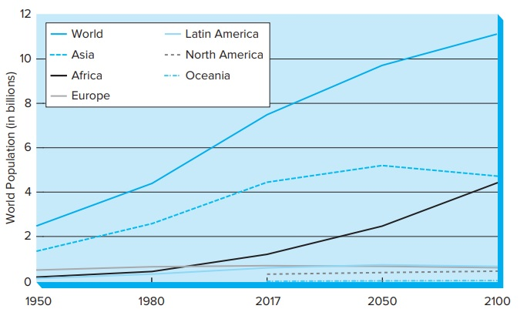
Population of the World and Major Areas
Figure 9.2
Copyright © McGraw-Hill Education. Permission required for reproduction or display.
Access the text alternative for these images.

Slide 7
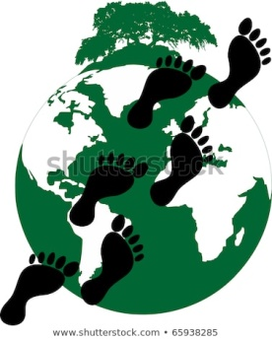
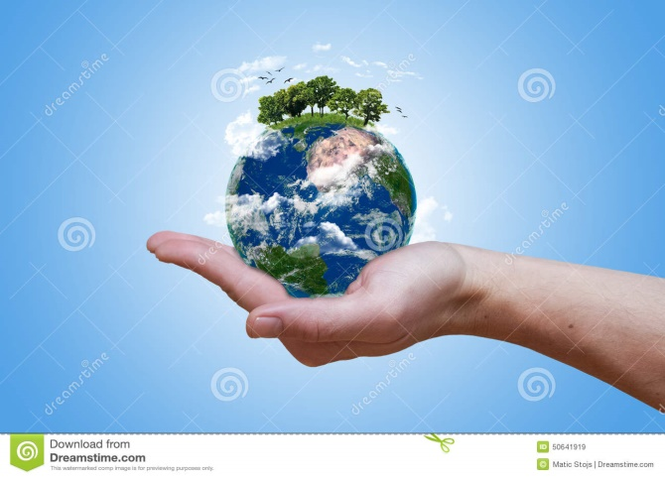
We Must be Aware of the Following
The Earth’s Carrying Capacity
Ecological Footprint
Notes:
The Earth’s Carrying Capacity
The Earth’s resource base is essentially finite, or bounded.
If human societies use up resources faster than they can be replenished, and create waste faster than it can be dispersed, environmental devastation will be the inevitable result.
Human society is already overshooting the carrying capacity of the Earth’s ecosystem.
Ecological Footprint
A method to measure the Earth’s carrying capacity and how far human society has overshot it.
It refers to the amount of land and water a human population needs to produce the resources it consumes and to absorb its wastes, given prevailing technology.
Society is now using resources and producing waste at greater than one and a half times what the ecosystem can sustainably support.

Slide 8
How can human society restore balance between Earth’s carrying capacity and society’s demands?
Technological innovation
Changing patters of consumption
“Getting the prices right”
Notes:
Technological innovation: Develop new technologies to produce energy, food, and other necessities of human life more efficiently and with less waste.
Changing patters of consumption: Individuals and organizations concerned about environmental impact could decide to consume less or choose less harmful products and services.
“Getting the prices right”: Some economists have called for public policies that impose taxes on environmentally harmful products or activities.

Slide 9
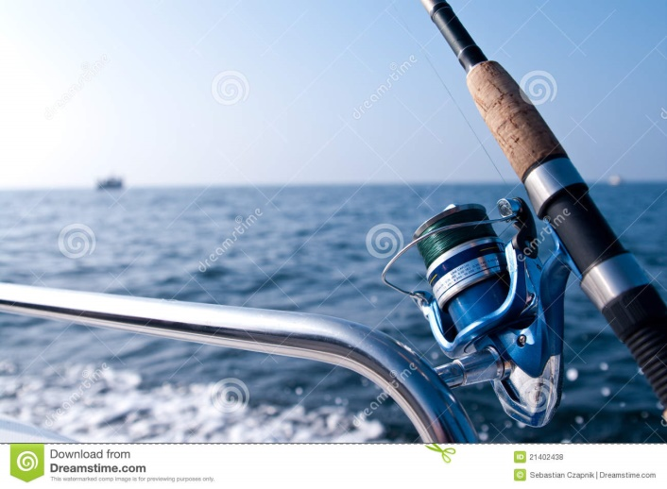
Global Environmental Issues
Commons
Tragedy of the commons
Notes:
Global Environmental Issues
Commons: a shared resource, such as land, air, or water that a group of people use collectively.
Paradox of the commons: if all individuals attempt to maximize their own private advantage in the short term, the commons may be destroyed, and all users, present and future, lose.
The only solution is restraint, either voluntary or through mutual agreement.
Tragedy of the commons: freedom in a commons brings ruin to all.
→ Example: Fishing grounds.

Slide 10
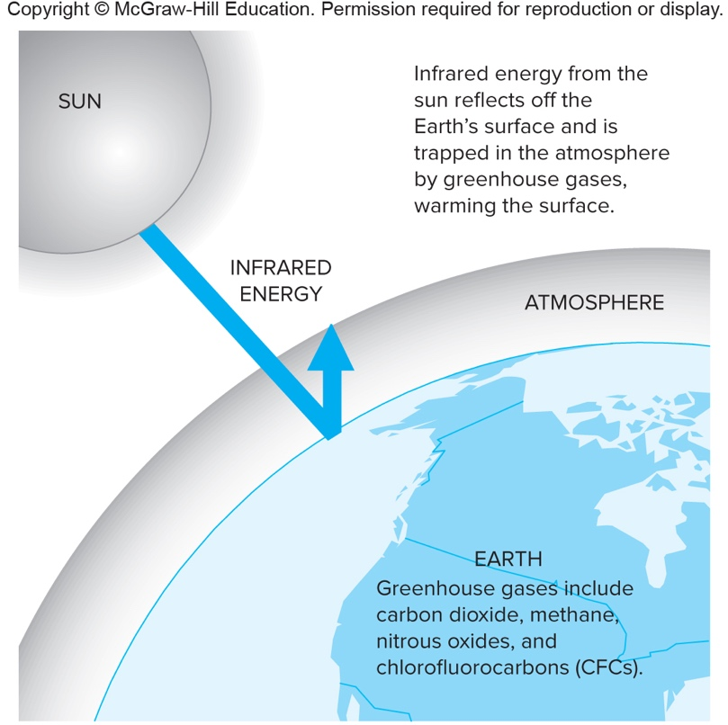
Global Warming
Copyright © McGraw-Hill Education. Permission required for reproduction or display.
Figure 9.3
Access the text alternative for these images.

Slide 11
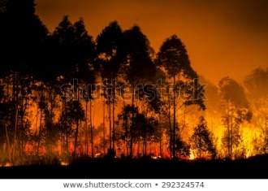
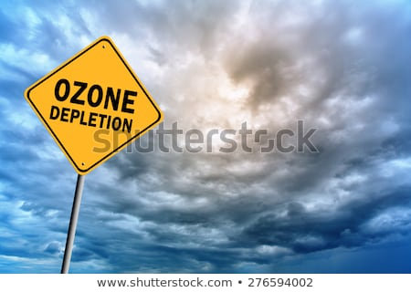
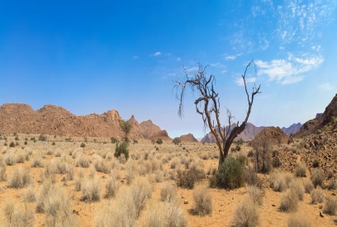
Five Global Problems:
Climate Change
Ozone Depletion
Resource Scarcity
Decline of Biodiversity
Notes:
1. Climate Change: Changes in the Earth’s climate caused by increasing concentrations of carbon dioxide and other pollutants produced by human activity.
Causes include:
Burning of fossil fuels.
Increased emissions of nitrous oxides.
Black carbon.
Deforestation.
Beef production.
The Convention on Climate Change is an international treaty that limits emissions of greenhouse gases, such as carbon dioxide.
2. Ozone Depletion
Ozone: bluish gas, composed of three bonded oxygen atoms, that floats in a thin layer in the stratosphere between 9 and 28 miles above the planet.
Causes: chlorofluorocarbons (CFCs), manufactured chemicals formerly widely used as refrigerants, insulation, solvents, and propellants in spray cans.
In 1987, world leaders negotiated the Montreal Protocol, agreeing to cut CFC production.
3. Resource Scarcity
Fresh Water
Only about one-tenth of 1 percent of the Earth’s water is in lakes, rivers, and accessible underground supplies, and thus available for human use.
Fresh water is renewable.
By the early 2010s, water shortages had already caused the decline of local economies and in some cases had contributed to regional conflicts.
Arable Land
World’s arable land is threatened with decline from soil erosion, loss of nutrients, water scarcity, salinization, and poor drainage.
→Example: Loss of arable land can lead to migration and civil unrest.
4. Decline of Biodiversity
Biodiversity: the number and variety of species and the range of their genetic makeup.
Scientists estimate that species extinction is occurring at 100 to 1,000 times the normal, background rate due to pollution and habitat destruction.
Genetic diversity is vital to each species’ ability to adapt and survive and has many benefits for human society as well.
A leading cause: Destruction of rain forests, particularly in the tropics.
The reasons for destruction of rain forests include commercial logging, cattle ranching, and conversion of forest to plantations to produce cash crops.

Slide 12

The Convention on Biological Diversity
By 2018 it had been ratified by all U.N. members except the United States.
Commits these countries:
  To draw up national strategies for conservation.
  To protect ecosystems and individual species.
  To take steps to restore degraded areas.
It also allows countries to share in the profits from sales of products derived from their biological resources.

Slide 13
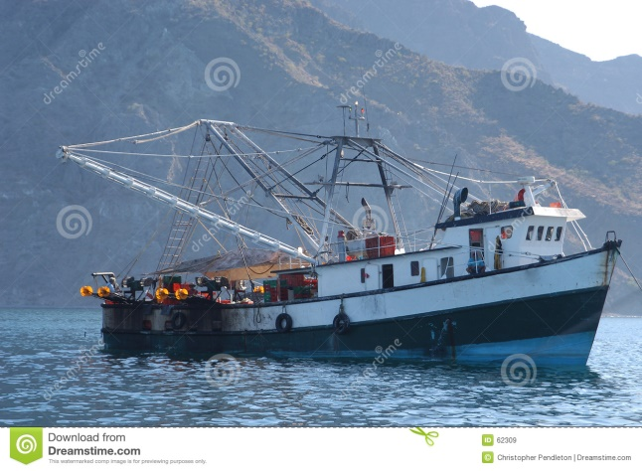
Five Global Problems:
5. Threats to Marine Ecosystems
Marine Ecosystems: oceans, salt marshes, lagoons, and tidal zones that border them, as well as diverse communities of life they support.
  Salt water covers 70 percent of the earth’s surface and supports many species.
Key threats to these ecosystems:
  Exploitation of fish populations.
  Decline of coral reefs.
  Coastal development in ecologically fragile areas.
  Ocean acidification.

Slide 14
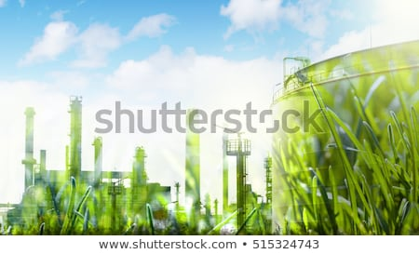
Response of the International Business Community
The international business community plays a critical role in addressing the ecological challenges.
Numerous voluntary initiatives are being undertaken by companies around the world to put the principle of sustainable development into practice.

Slide 15

Voluntary Business Initiatives1
Life cycle analysis
Industrial ecology
Extended product responsibility
Carbon neutrality
Technology cooperation
Notes:
Life cycle analysis
Involves collecting information on the lifelong environmental impact of a product, from extraction of raw material to manufacturing to its distribution, use, and ultimate disposal.
Industrial ecology
Refers to designing factories and distribution systems as if they were self-contained ecosystems.
Extended product responsibility
Occurs when companies take continuing responsibility for the environmental impact of the products and services, even after they are sold.
Carbon neutrality
An organization or individual produces net zero emission of greenhouse gases; this is usually accomplished by a combination of energy efficiencies and carbon offsets.
Technology cooperation
Sustainable development through long-term partnerships between companies in developed and developing countries to transfer environmental technologies.

Slide 16

Voluntary Business Initiatives2
Carbon neutrality
Technology cooperation
Notes:
Carbon neutrality
An organization or individual produces net zero emission of greenhouse gases; this is usually accomplished by a combination of energy efficiencies and carbon offsets.
Technology cooperation
Sustainable development through long-term partnerships between companies in developed and developing countries to transfer environmental technologies.

Slide 17
Codes of Environmental Conduct
Business Charter for Sustainable Development
CERES Principles
ISO 14000
The Greenhouse Gas Protocol
Notes:
Some of the leading universal codes include the following:
Business Charter for Sustainable Development – developed by the International Chamber of Commerce.
CERES Principles – developed by the Coalition for Environmentally Responsible Economies.
ISO 14000 – a series of voluntary standards developed by the ISO, an international group based in Switzerland.
The Greenhouse Gas Protocol – to help businesses measure and manage their greenhouse gas emissions.
Many executives are championing the idea that corporations have moral obligations to future generations.

Slide 18
Sustainable Development and Global Business
Chapter 9
©2020 McGraw-Hill Education. All rights reserved. Authorized only for instructor use in the classroom. No reproduction or further distribution permitted without the prior written consent of McGraw-Hill Education.

